Slide 1
NFL
IST 652
Brandon O’Linn and Santiago Lampon
Dr. Deborah Landowski
Passing and Rushing Comparisons

Slide 2
Introduction
How sports are played changes all the time and football is no exception. Football used to be a game dominated by prolific running backs with the quarterbacks playing more like game managers. In the last several years that has drastically changed. Teams are throwing the ball now more than ever. Running backs are now more agile and have the same ability to catch the ball as most receivers. In fact, it seems like if a running back can’t catch the ball there is not room for them in the NFL. Quarterbacks are no longer game managers but the most important and valued players in the game. Some quarterbacks used to have less than 20 passing attempts in a game, now some of them are throwing 40 to 50 times a game with Kansas City Chiefs quarterback Patrick Mahomes recently throwing 68 passing attempts in one game. The purpose of this analysis is to explore how the game of football has changed from 2019 to 2022 by looking at team data and individual player data.

Slide 3
Data Sets
Three datasets were used to explore the changes in how football is played the first is from NFL_data_py, the second is from web scraping NFL stats from Pro Football Reference, and the third is from a CSV provided by https://www.advancedsportsanalytics.com/nfl-raw-data.
nfl_data_py is a Python library for interacting with NFL data sourced from nflfastR, nfldata, dynastyprocess, and Draft Scout. For this project, we used the nfl_data_py function to bring in nfl play-by_play data, roster data, and team description to later join the three tables into one. The data we have loaded has extremely rich play-by-play data taken from the NFL API.
We pulled quarterback stats from the 2019 and 2020 NFL seasons from https://www.pro-football-reference.com/years/2019/passing.html and use them to create radar charts to assess QB efficiency. To open the webpage and scrape the data, we will use two modules, urllib.request to open the URL, and BeautifulSoup to parse through the HTML.

Slide 4
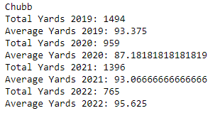
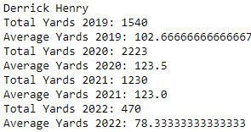
Exploratory Analysis
Exploratory analysis was done to see year to year stats of some of our favorite players. These players included Nick Chubb and Derrick Henry two of the NFLs best running backs. We looked to see if their rushing yards per game dropped over the years.
Notes:
The results show that for both Chubb and Henry held steady or even increased their production from 2019-2022. Although halfway through the 2022 season Henry is off to a shaky start compared to recent years. Possibly due to teams scheming against him because his last three season were insane.

Slide 5
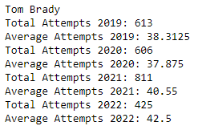
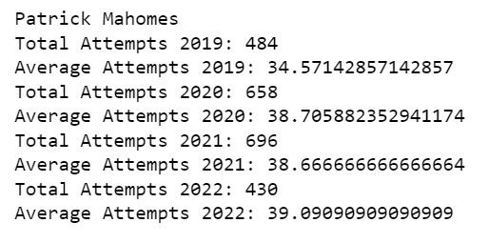
Exploratory Analysis cont.
Next, we looked at Tom Brady and Patrick Mahomes Passing attempts.
The results of this show that Brady increased from 38 attempts per game in 2019 to 42.5 per game so far in 2022. Mahomes who came into the league throwing a lot in the Texas Tech air raid offense has always had a lot of passing attempts but surprisingly his attempts haven’t fluctuated much and has been consistently at 38 to 39 a game other than 2019 when he only threw for 34 attempts per game. He does however have some huge outliers with 50 and 54 attempt games in 2021.

Slide 6
Quarterback Efficiencies
We wanted to display into a radar graph all the attributes of the quarterbacks for the 2019 and 2020 season just to show the possibilities of data analytics in sports. The code will show the output of all the quarterbacks efficiency graphs for 2019 and 2020 seasons.
TD = Total touchdowns thrown in the season
Yds = Total yards thrown in the season
Int = Total interceptions thrown in the season Note: this stat is inverted
Y/A = Yards per passing attempts
Rate = Quarterbacks rating at the end of the season
Cmp% = Completion percentage at the end of the season
Next, I will just show a few and talk about some comparisons between the two seasons for some quarterbacks.

Slide 7
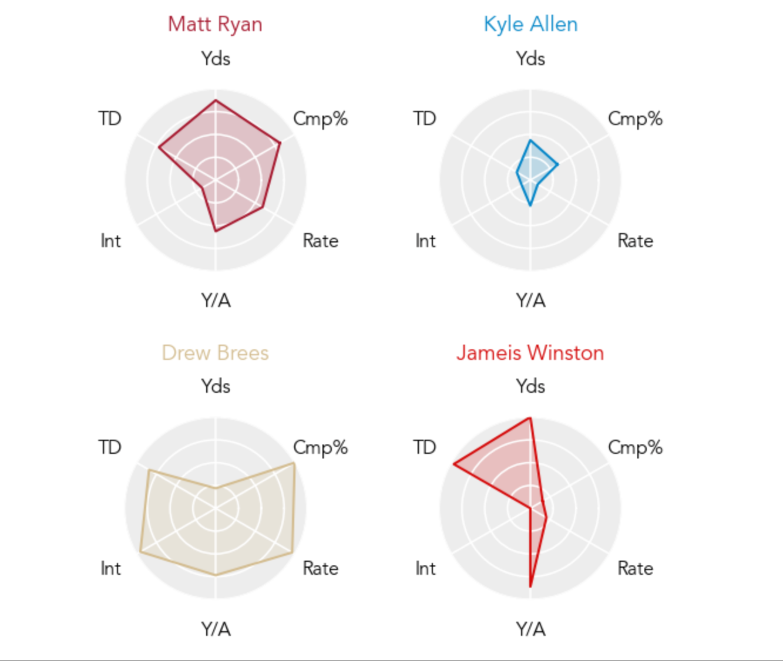
Quarterback Efficiencies
NFC South - 2019

Slide 8
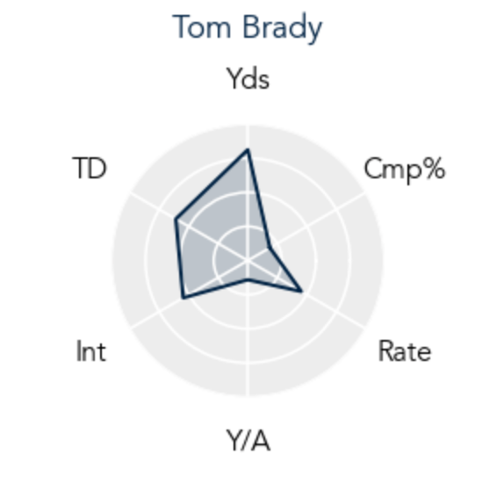
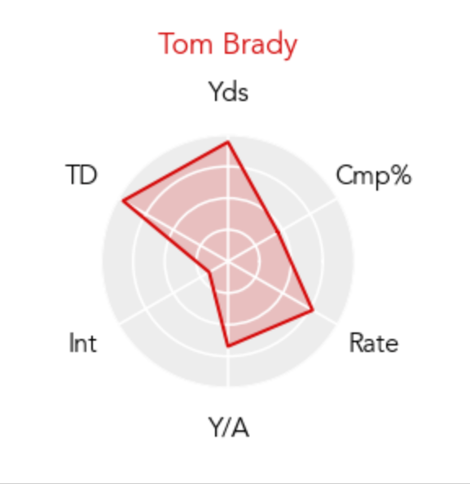
Quarterback Efficiencies
Tom Brady– 2020 First Season with Tampa Bay Buccaneers *Won the Super Bowl
Tom Brady – 2019 Last year with the New England Patriots

Slide 9
nfl_data_py
For this project, we used the nfl_data_py function to bring in nfl play-by_play data, roster data, and team description to later join the three tables into one.
Data is available going back to 2009. We wanted to show a different way to access information using the API’s already available in python. Three tables were brought in and used a left and right join to link the three data sets into one.
The next graphs will show the production of the quarterbacks in the 2021 season. This graph is excluding the playoffs and 2-point conversions. We also brought in the quarterbacks that had more than 4,000 yards passing for the season.

Slide 10
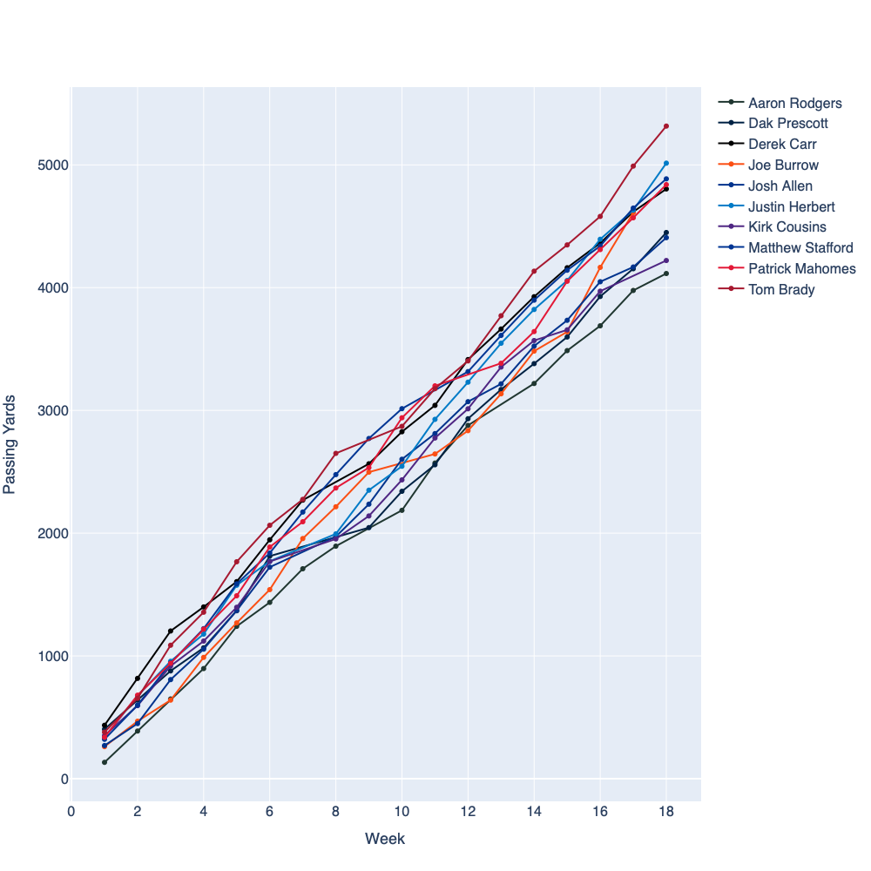
nfl_data_py
Top 5 Passing Yds QB
Tom Brady 5316 yards
Justin Herbert 5014 yards
Matthew Stafford 4886 yards
Patrick Mahomes 4836 yards
Derek Carr 4804 yards

Slide 11
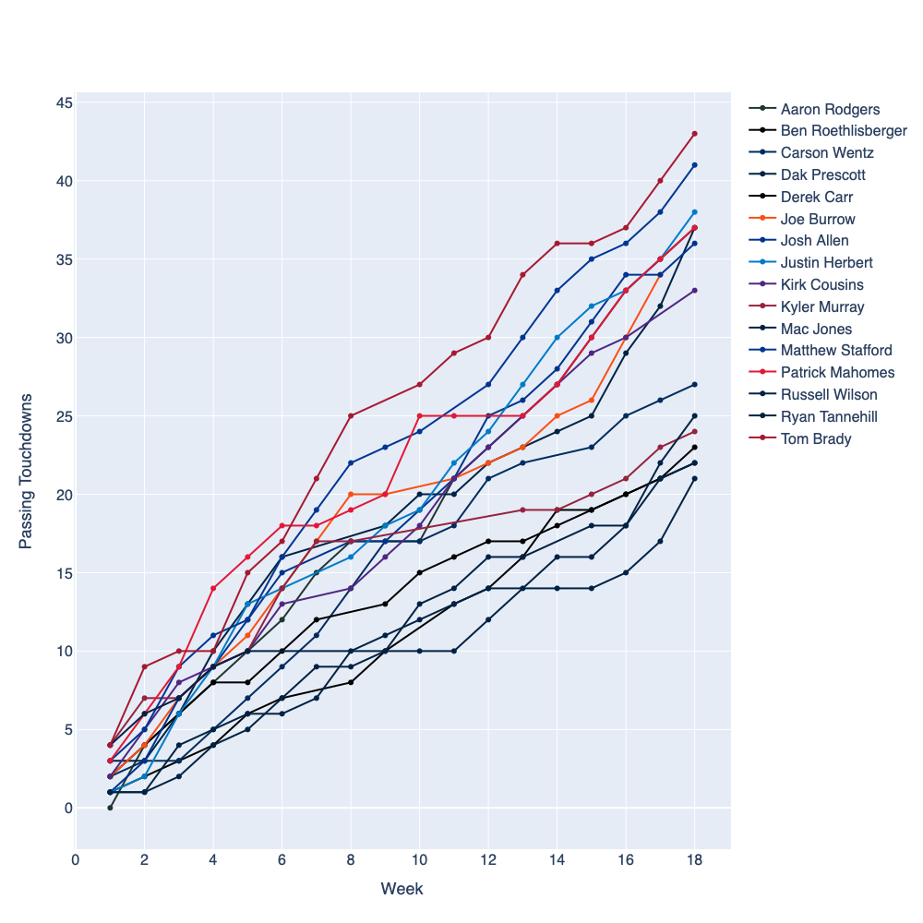
nfl_data_py
Top 5 Passing TD QB
Tom Brady - 43
Matthew Stafford – 41
Justinn Herbert - 38
Patrick Mahomes - 37
Dak Prescott - 37

Slide 12
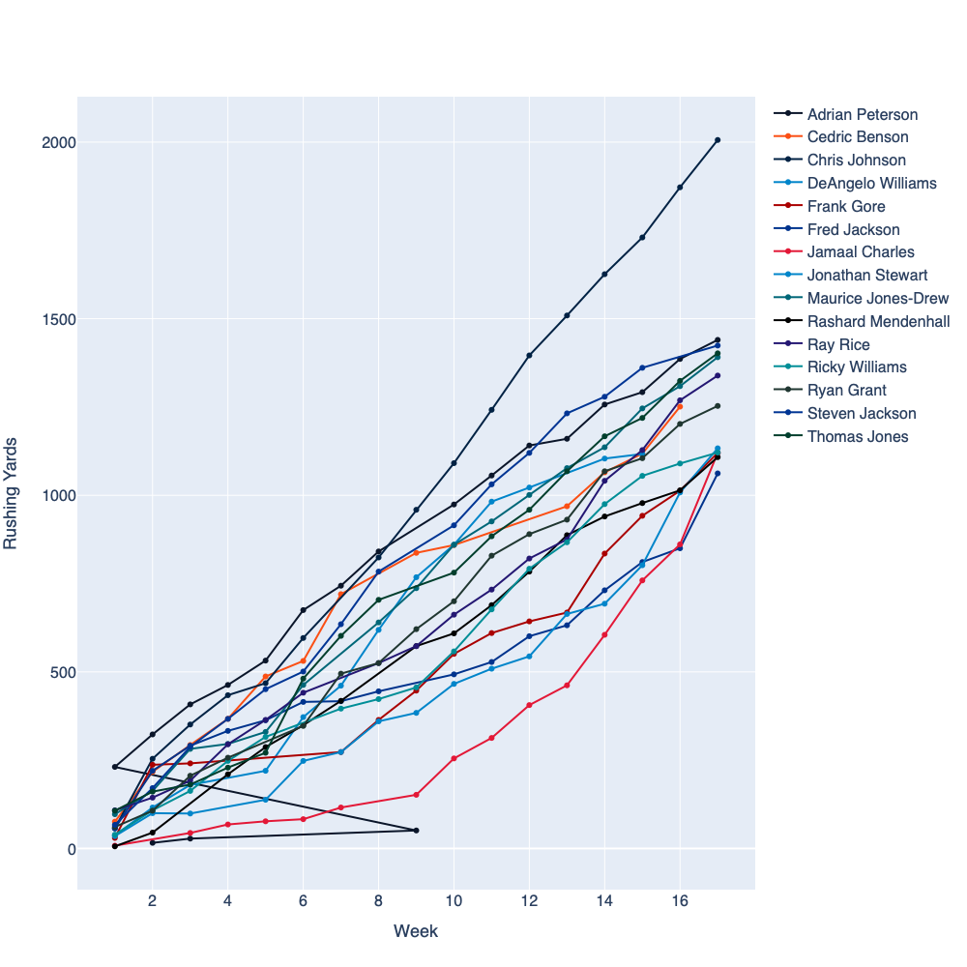
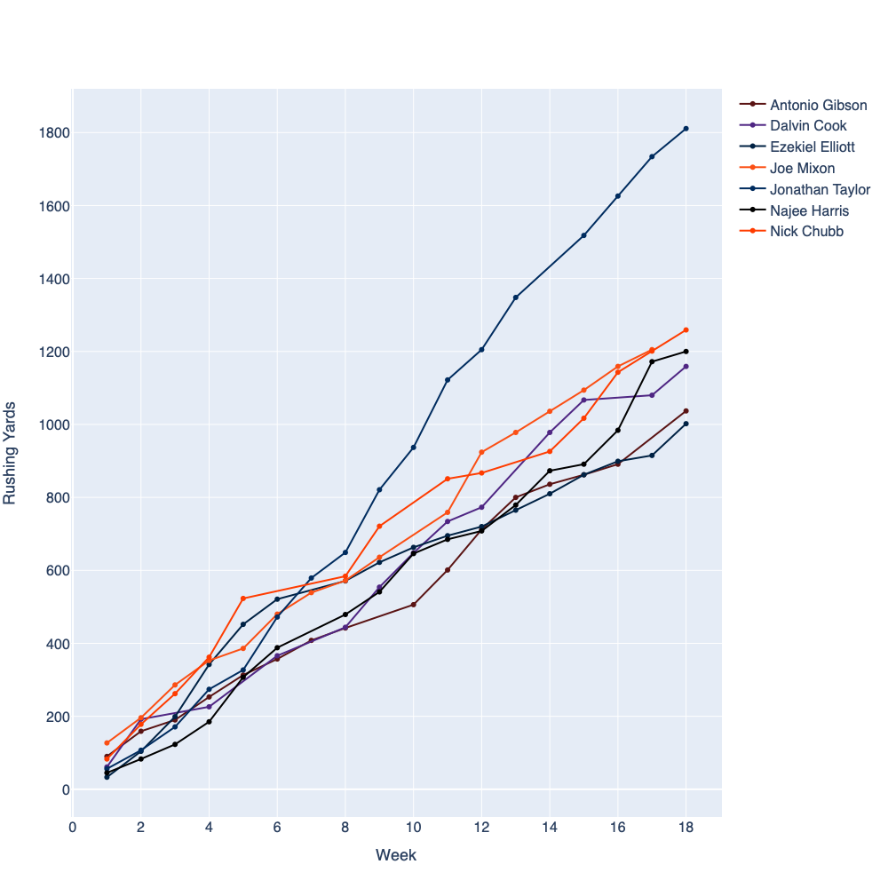
nfl_data_py
2009 Season
2021 Season
Running Backs
2009
15 RBs with over 1000 yds
rushing
2021
7 RBs with over
1000 yds rushing

Slide 13
Conclusion
A running back by committee is a strategy employed by football teams in which more than one running back shares a relatively similar percentage of carries. Many teams in the NFL employ more than one running back who usually have different strengths and weaknesses. Ultimately, showing that having two-three running backs that can collectively rush for over 1,000 yards is the same as having one running back that can do the same.
Although it seemed as though in football to pass the ball more you would have to run the ball less our analysis showed us that while passing did increase over the years it did not negatively impact the number of running plays an individual team ran. This could be because offense is booming and as fast as ever meaning teams could be running more total plays. We also saw that elite running back can still be elite and have a heavy workload. Some of the biggest and best names at the QB position are averaging around 40 passes per game.

